Slide 1

Email marketing report

Slide 2
Overall marketing goal
Our goal is to increase summer season ticket sales by 10% over last year’s numbers through a combination of targeted paid, social, and email marketing campaigns.

Slide 3
Email marketing goal
To support the overall goal of selling more tickets, we want to raise open rates and click-to-open rates for campaign emails.
We want to know:
What types of emails have performed the best with different subscriber segments in the past?
What types of email content should we prioritize for each segment in our new campaign?

Slide 4
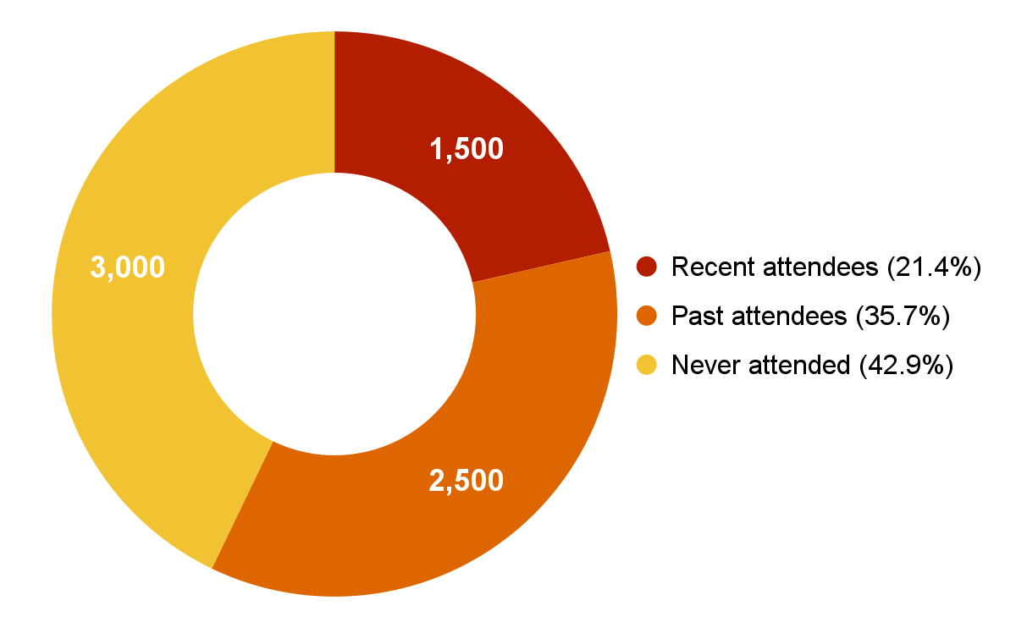
Email subscriber segments
Notes:
Summary: We want to increase engagement with campaign emails across all segments because recent attendees make up only about one fifth of our subscriber list. Past attendees and subscribers who have never attended a performance make up over three quarters of our email list. In order to reach our overall goal of a 10% increase in attendance, we need to engage these segments more effectively.

Slide 5
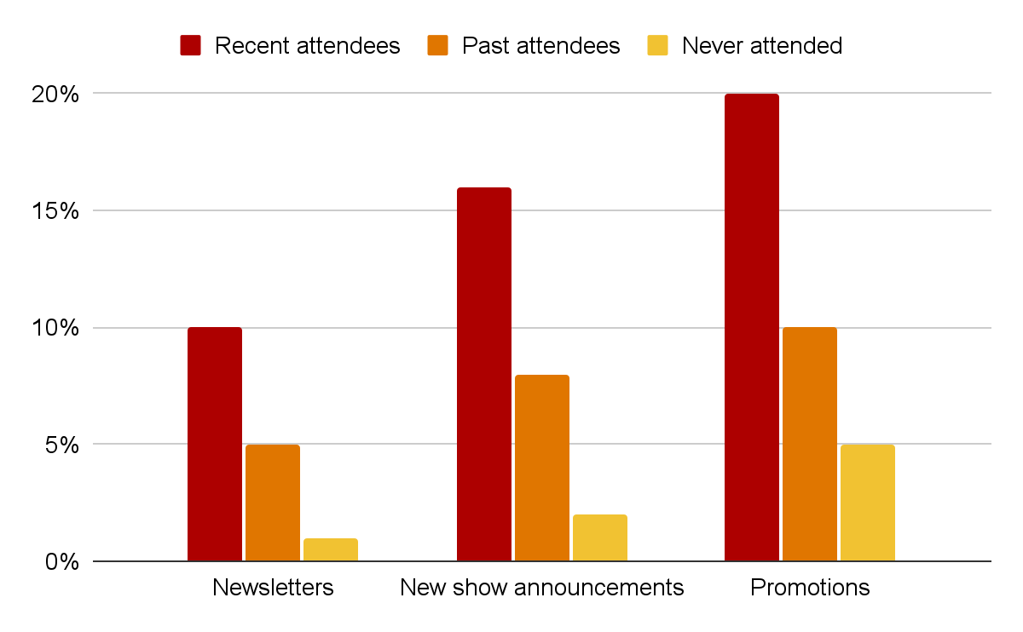
Open rates by email category
Notes:
Summary: New show announcements perform relatively well with recent and past attendees, when compared with promotional emails. But promotional emails have the highest open rate across all three subscriber segments. Since promotions perform well with all subscribers, we may be able to optimize open rates by understanding the types of promotions each segment responds to best.

Slide 6
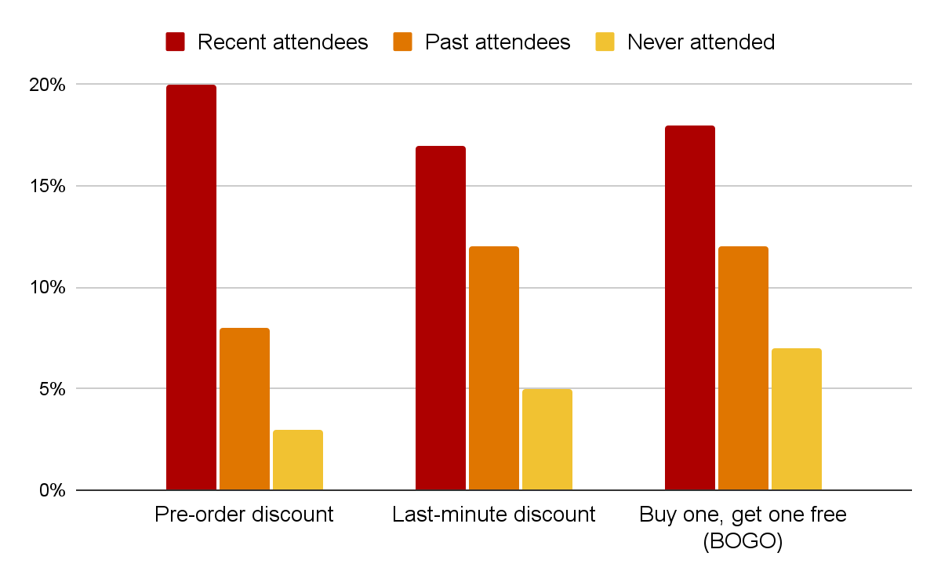
Open rates by promotion type
Notes:
Summary: When focusing on promotional emails, there is more variation among subscriber segments. All three types of promotions have high open rates among recent attendees, with pre-order discounts being the most successful. Past attendees open last-minute discounts and buy one, get one free promotions at about equal rates. Subscribers who have never attended a performance show a clear preference for buy one, get one free promotions. Subscribers who open emails aren’t always engaging with them, however, so we need to examine additional metrics.

Slide 7
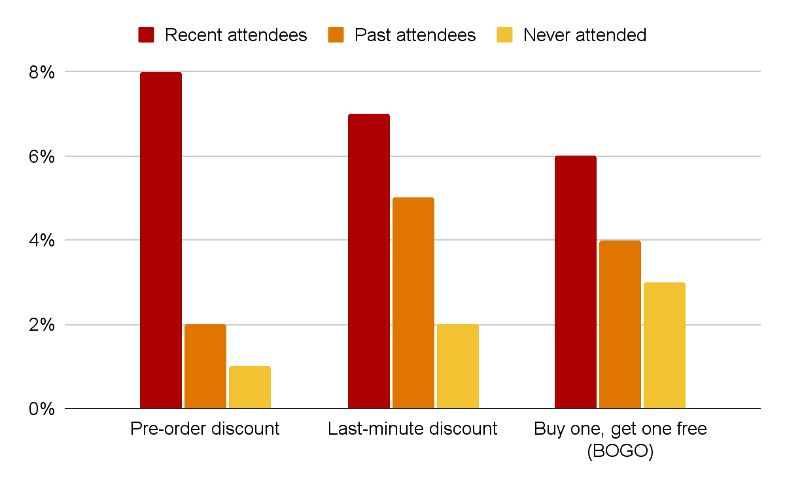
Click-to-open rates by promotion type
Notes:
Summary: To understand what percentage of email openers are engaging with the emails they open, we need to take click-to-open rates into account. Recent attendees are most likely to engage with pre-order discount emails. Although they’re slightly more likely to open BOGO emails, they’re slightly more likely to click links in last-minute promotions. Past attendees also engage with last-minute discounts at a slightly higher rate than BOGO emails. Subscribers who have never attended a performance are most likely to open and engage with BOGO discounts.

Slide 8
Conclusion and recommendations
Recent attendees: Receptive to announcements and all types of promotions, with slight preference for pre-order discounts. Prioritize early and last-minute communications and discounts.
Past attendees: About equally receptive to last-minute and BOGO promotions, with last-minute being slightly more effective. Prioritize both.
Never attended: Most receptive to BOGO promotions in both open rate and CTOR. Prioritize this type of promotion for this group.

